Slide 1
Inter-process Communication (IPC)
Processes frequently needs to communicate with each other. For example, the output of first process must passed to the second process and so on. Thus there is the need of communication between processes in a well structured way.
IPC enables one application to control another application and for several applications to share the same data without interfering with one another.

Slide 2
Inter-process Communication (IPC)
A process can be of two types:
Independent process.
Co-operating process.
An independent process is not affected by the execution of other processes while a co-operating process can be affected by other executing processes.
Inter process communication (IPC) is a mechanism which allows processes to communicate with each other and synchronize their actions.
The communication between these processes can be seen as a method of co-operation between them.

Slide 3
Cooperating Processes
A process is independent if it can’t affect or be affected by another process. A process is co-operating if it can affects other or be affected by other processes.
Any process that share data with other process is called co-operating process.
There are many reasons for providing an environment for process co-operation such as information sharing, computation speedup (breakup task into subtasks), modularity (to construct system into modular fashion), etc.

Slide 4
Fundamental ways of IPC
There are two fundamental ways of IPC.
Shared Memory
Message Passing

Slide 5
Shared Memory
Here, a region of memory that is shared by co-operating process is established.
Process can exchange the information by reading and writing data to the shared region.
System calls are required only to establish share memory regions. Once shared memory is established no assistance from the kernel is required.

Slide 6
Message Passing
Communication takes place by means of message exchanged between the co-operating process.
Message passing is useful for exchanging the smaller amount of data since no conflict need to be avoided.
Slower than shared memory as message passing system are implemented using system call which requires more time consuming task of kernel.

Slide 7
Race Condition
A race condition is an undesirable situation that occurs when a device or system attempts to perform two or more operations at the same time, but because of the nature of the device or system, the operations must be done in the proper sequence to be done correctly.
The situation where two or more processes are reading or writing some shared data and final results depends on who runs precisely when are called race conditions.

Slide 8
Critical Region/Section
When more than one processes access a same code segment that segment is known as critical section.
Critical section contains shared variables or resources which are needed to be synchronized to maintain consistency of data variable.

Slide 9
Avoiding Race Condition
To avoid race condition, we need mutual exclusion.
Mutual Exclusion is someway of making sure that if one process is using a shared variable or file, the other processes will be excluded from doing the same things.
If we could arrange matters in such that no two processes were ever in their critical regions at the same time, we could avoid race conditions.

Slide 10
Rules for avoiding Race Condition/Solution to Critical Section Problem
No two processes may be simultaneously inside their critical regions. (Mutual Exclusion)
No assumptions may be made about speeds or the number of CPUs.
No process running outside its critical region may block other processes.
No process should have to wait forever to enter its critical region.

Slide 11
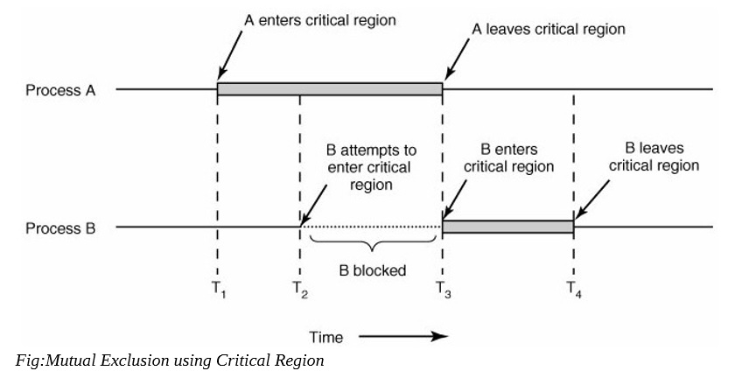
Mutual Exclusion using Critical Region

Slide 12
Techniques for avoiding Race Condition
Disabling Interrupts
Lock Variables
Strict Alteration
Peterson’s Solution
TSL Instruction
Sleep and Wakeup
Semaphores
Message Passing

Slide 13
Disabling Interrupts
Each process disable all interrupts just after entering its critical region and re-enable them just before leaving it.
With interrupt disabled, no clock interrupts can occur and hence no switching between processes.
Once a process has disable interrupts, it can examine and update the shared memory without fear that any other process will intervene.
Flaw:-It is unwise to give user processes the power to turn off interrupts. Suppose that one of them did, and then never turned them on again?

Slide 14
Lock Variables
A single, shared (lock) variable, initially 0.
When a process wants to enter its critical region, it first tests the lock.
If the lock is 0, the process sets it to 1 and enters the critical region.
If the lock is already 1, the process just waits until it becomes 0.
0 means that no process is in its critical region.
1 means that some process is in its critical region.
Flaw:- Suppose that one process reads the lock and sees that it is 0.Before it can set the lock to 1, another process is scheduled, runs and sets the lock to 1. when the first process runs again, it will also set the lock to 1, and two processes will be in their critical region. (like as in spooler directory)

Slide 15
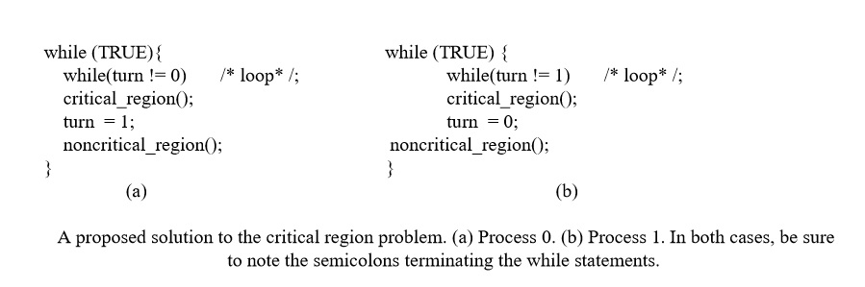
Strict Alteration/Turn Variable

Slide 16
Strict Alteration/Turn Variable
The integer variable 'turn' keeps track of whose turn is to enter the critical section.
Initially, process A inspect turn, finds it to be 0, and enters in its critical section.
Process B also finds it to be 0 and sits in a loop continually testing 'turn' to see when it becomes 1.
Continuously testing a variable waiting for some value to appear is called the Busy-Waiting.
Flaw:- Taking turns is not a good idea when one of the processes is much slower than the other. Suppose process 0 finishes its critical section quickly, so both processes are now in their noncritical section. This situation violates above mentioned condition 3 (No process running outside the critical region may block other process)

Slide 17
Peterson’s Solution
Peterson's algorithm (or Peterson's solution) is a concurrent programming algorithm for mutual exclusion that allows two or more processes to share a single-use resource without conflict, using only shared memory for communication.
It was formulated by Gary L. Peterson in 1981.
The algorithm uses two variables, flag and turn. A flag[n] value of true indicates that the process n wants to enter the critical section. Entrance to the critical section is granted for process P0 if P1 does not want to enter its critical section or if P1 has given priority to P0 by setting turn to 0.

Slide 18
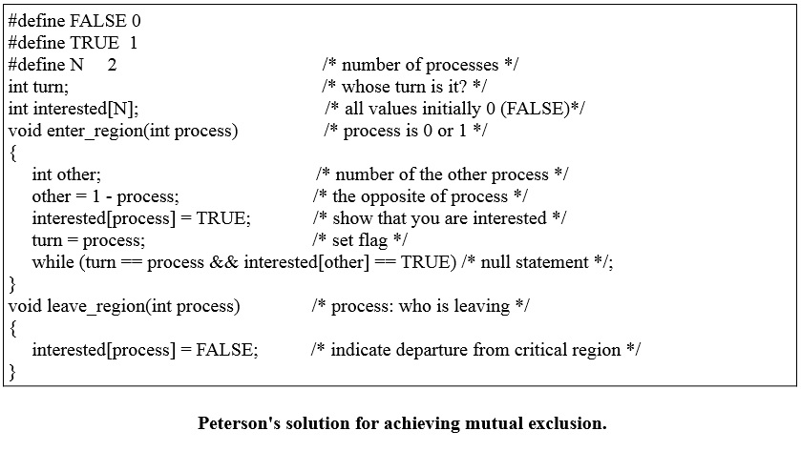
Peterson’s Solution

Slide 19
Peterson’s Solution
Initially neither process is in its critical region.
Now process 0 calls enter_region(). It indicates its interest by setting its array element and sets turn to 0. since process 1 is not interested, enter_region() returns immediately.
If process 1 now calls enter_region(), it will hang there until interested[0] goes FALSE, an event that will only happens when process 0 calls leave_region() to exit the critical region.

Slide 20
Peterson’s Solution
Now, consider the case that both processes call enter_region() almost simultaneously. Both will store their process number in turn. Whichever store is done last is the one that counts, the first one is lost.
Suppose that the process 1 stores last, so turn is 1. when both processes come to the while statement, process 0 executes it zero times and enters its critical region. Process 1 loops and does not enters its critical region.

Slide 21
The TSL (Test and Set Lock) Instruction
TSL RX, LOCK->it reads the contents of the memory word LOCK into register RX and then stores nonzero value at the memory address LOCK.
The operations of reading the word and storing into it are guaranteed to be indivisible i.e no other processor can access the memory word until the instruction is finished.
The CPU executing the TSL instruction locks the memory bus to prohibit other CPUs from accessing memory until it is done.

Slide 22
Problems with Mutual Exclusion
The above techniques uses Busy waiting i.e. here while one process is busy updating shared memory in its critical region, no other process will enter its critical region and cause trouble.
The process just sits in a tight loop waiting for its turn.
Busy waiting approach waste CPU time.
There can be an unexpected problem called priority inversion problem.

Slide 23
Priority Inversion Problem
Priority inversion is a scenario in scheduling in which a high priority task is indirectly preempted by a lower priority task effectively inverting the relative priorities of the two tasks. This implies the inversion of the priorities of the two processes.
Consider a computer with two processes, H, with high priority and L with low priority, which share a critical region. The scheduling rules are such that H is run whenever it is in ready state. At a certain moment, with L in its critical region, H becomes ready to run. H now begins busy waiting, but since L is never scheduled while H is running, L never gets the chance to leave its critical region. So H loops forever. This situation is referred to as the priority inversion problem.

Slide 24
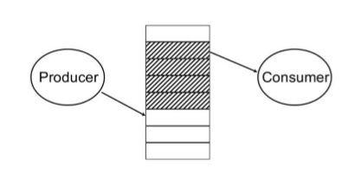
Sleep and wakeup
Sleep and wakeup are system calls that blocks process instead of wasting CPU time when they are not allowed to enter critical region.
Sleep is a system call that causes the caller to block, that is, be suspended until another process wakes it up.
The wakeup call has one parameter, the process to be awakened.
Ex: Producer-Consumer Problem
(Bounded Buffer)

Slide 25
Producer-Consumer Problem (Bounded Buffer)
The Producer-Consumer problem is a classic problem this is used for multi-process synchronization i.e. synchronization between more than one processes.
In the producer-consumer problem, there is one Producer that is producing something and there is one Consumer that is consuming the products produced by the Producer. The producers and consumers share the same memory buffer that is of fixed-size.
The job of the Producer is to generate the data, put it into the buffer, and again start generating data. While the job of the Consumer is to consume the data from the buffer.

Slide 26
Problem
The producer should produce data only when the buffer is not full. If the buffer is full, then the producer shouldn't be allowed to put any data into the buffer. (If the buffer is already full, producer goes to sleep and to be awakened when the consumer has removed data)
The consumer should consume data only when the buffer is not empty. If the buffer is empty, then the consumer shouldn't be allowed to take any data from the buffer. (if buffer is already empty, consumer goes to sleep until the producer puts some data in buffer and wakes consumer up)
The producer and consumer should not access the buffer at the same time.

Slide 27
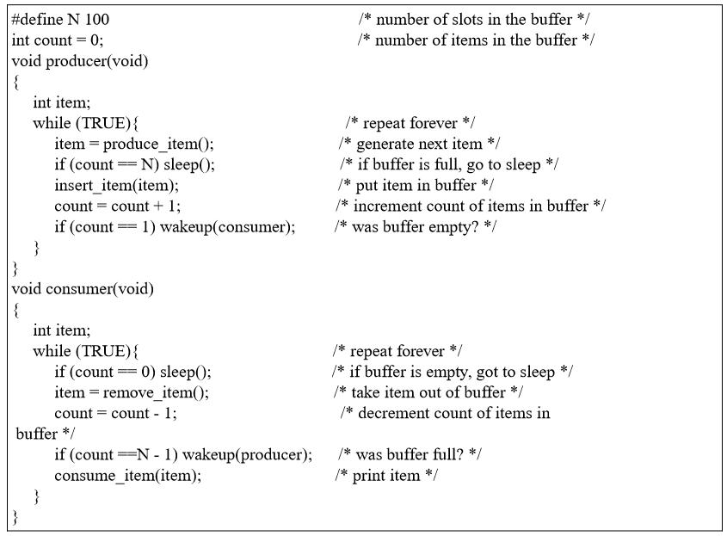
Producer Consumer problem with fatal Race condition

Slide 28
Semaphore
A semaphore is a protected variable or abstract data type that constitutes a classic method of controlling access by several processes to a common resource in a parallel programming environment.
It is a synchronization tool that does not require busy waiting.
A Semaphore is a special kind of integer variable which can be initialized and that is used to solve the critical section problem by using two atomic operations, wait and signal that are used for process synchronization.

Slide 29
Wait/Down/P operation:
The wait operation decrements the value of its argument S, if it is positive. If S is negative or zero, then no operation is performed. (P stands for Proberen “to test”)
Decrement the semaphore value. If negative, suspend the process and place in a queue.
wait(S):
while (S<=0)
do no_op;
S--;

Slide 30
Signal/Up/V-Operation:
The signal operation increments the value of its argument S i.e. increment semaphore by 1. (V stands for Verhogen “increase”).
Increment the semaphore value, allow the first process in the queue to continue.
signal(S):
S++;

Slide 31
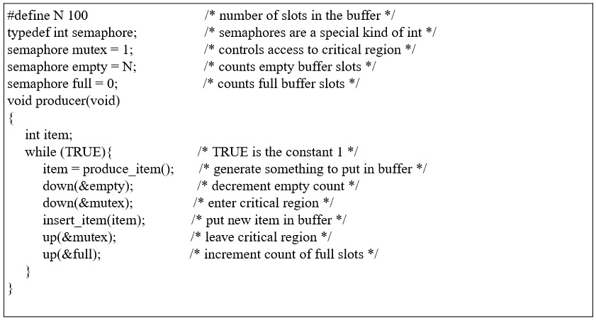
Producer Consumer Problem using Semaphore

Slide 32
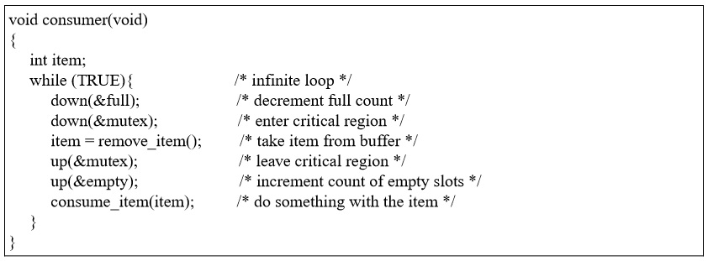
Producer Consumer Problem using Semaphore

Slide 33
Classical IPC Problems
Some Classical IPC Problems:
Dining Philosophers Problem
The Readers and Writers problem
The Sleeping Barber problem

